Slide 1
Part Two: Security Principles
Chapter 2.3
Hash Function Standard

Slide 2
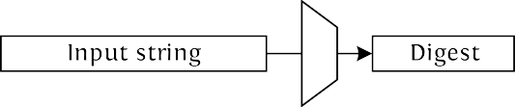
Cryptographic hash functions
Function h from
Typical values for n: 128, 160, 256, 512
Pre-image resistant: it shall take 2^{n} eﬀort to
given y, ﬁnd x such that h(x) = y
2nd pre-image resistance: it shall take 2^{n} eﬀort to
given M and h(M), ﬁnd another M′ with h(M′) = h(M)
Collision resistance: it shall take 2^{n/2} eﬀort to
ﬁnd x₁ < > x₂ such that h(x₁ ) = h(x₂)

Slide 3
Birthday Attack
Birthday attacks are a class of brute-force techniques that target the cryptographic hash functions. The goal is to take a cryptographic hash function and find two different inputs that produce the same output.
What is the probability that at least two of k randomly selected people have the same birthday? (Same month and day, but not necessarily the same year.)
p = 1- (365-1)/365 x (365-2)/365 x (365-3)/365 x ...... x (365-k+1)/365
Notes:
https://www.youtube.com/watch?v=4shxYyV4O_k
https://www.youtube.com/watch?v=Bp1mN_IFLNU
https://www.youtube.com/watch?v=QrwV6fJKBi8

Slide 4
The Birthday Paradox
How large must k be so that the probability is greater than 50 percent?
The answer is 23
(The probability is about 50.73%)

Slide 5
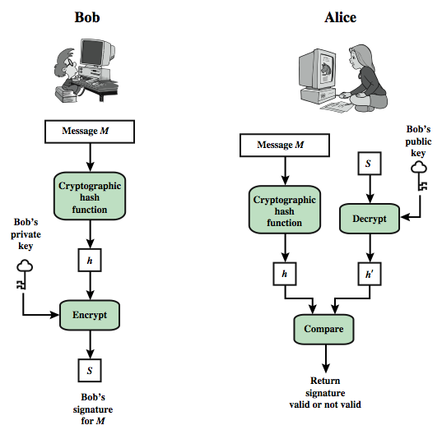
Digital Signature Model

Slide 6
Message Authentication Code
A MAC scheme is used for message authentication
MAC(M,K) = H(M,K)
The sender and the receiver share secret K
The sender sends (M, H(M,K))
The receiver receives (X,Y) and verifies that H(X,K)=Y, if so, then accepts the message as from the sender
To be secure, an adversary shouldn’t be able to come up with (X’,Y’) such that H(X’,K)=Y’.

Slide 7
Data Integrity
Integrity – ensures that unauthorized parties are not able to modify transmitted and stored information.
Data integrity is the opposite of data corruption, which is a form of data loss.
Applications: digital signature, MAC, commitment, checksum ...

Slide 8
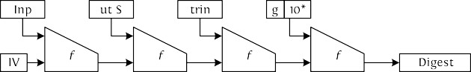
Classical way to build hash functions
Merkle-Damgård iterating mode
Instances: MD5, SHA-1, SHA-2 (224, 256, 384, 512) …

Slide 9
The origins of the SHA-3 competition
2005-2006: NIST thinks about having a SHA-3 contest
MD5 and standard SHA-1 were damaged by attacks
SHA-2 based on the same principles than MD5 and SHA-1 open call for SHA-2 successor
…and for analysis, comparisons, etc.
October 2008: Deadline for proposals
more eﬃcient than SHA-2
output lengths: 224, 256, 384, 512 bits
security: collision and (2nd) pre-image resistant specs, reference and optimized code, test vectors design rationale and preliminary analysis
patent waiver
Notes:
Xiaoyun Wang, Academician

Slide 10
The SHA-3 competition
First round: October 2008 to summer 2009
64 submissions, 51 accepted
37 presented at 1st SHA-3 candidate conf. in Leuven, February 2009 many broken by cryptanalysis
NIST narrowed down to 14 semi-ﬁnalists
Second round: summer 2009 to autumn 2010
analysis presented at 2nd SHA-3 conf. in Santa Barbara, August 2010 NIST narrowed down to 5 ﬁnalists
Third round: autumn 2010 to October 2012
analysis presented at 3rd SHA-3 conf. in Washington, March 2012
October 2, 2012: NIST announces Keccak as SHA-3 winner

Slide 11
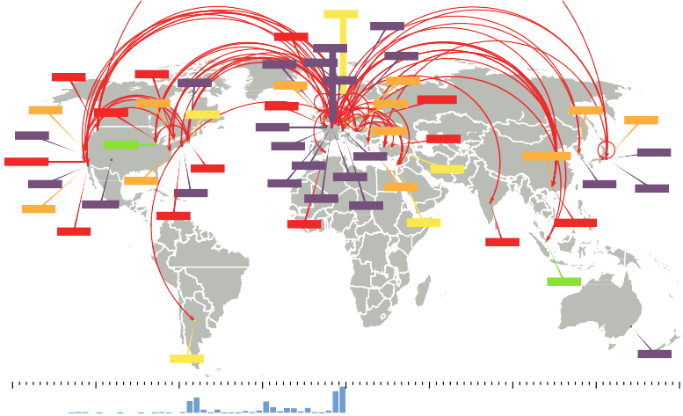
NIST SHA-3: the battleﬁeld
EDON-R
BMW
Sgàil
LANE
Grøstl
ZK-Crypt ^{Keccak}
Maraca
NKS2D
MD6
Waterfall
Hamsi
MeshHash
Abacus
ECOH
EnRUPT
_{Twister} StreamHash
MCSSHA3
WaMM
Ponic
AURORA
Skein
Shabal
LUX
SHAMATA
CubeHash
CRUNCH
Cheetah
DynamicSHA 2
Luﬀa
Spectral Hash
DCH
ECHO
Sarmal
SWIFFTX
ESSENCE
FSB
SIMD
NaSHA
ARIRANG
Lesamnta
SANDstorm
Fugue
SHAvite-3
BLAKE
Blender
HASH 2X
BOOLE
Tangle
Vortex
DynamicSHA
Khichidi-1
JH
TIB3
16/06/2009
CHI
2005
2006
2007
2008
2009
2010
2011
2012

Slide 12
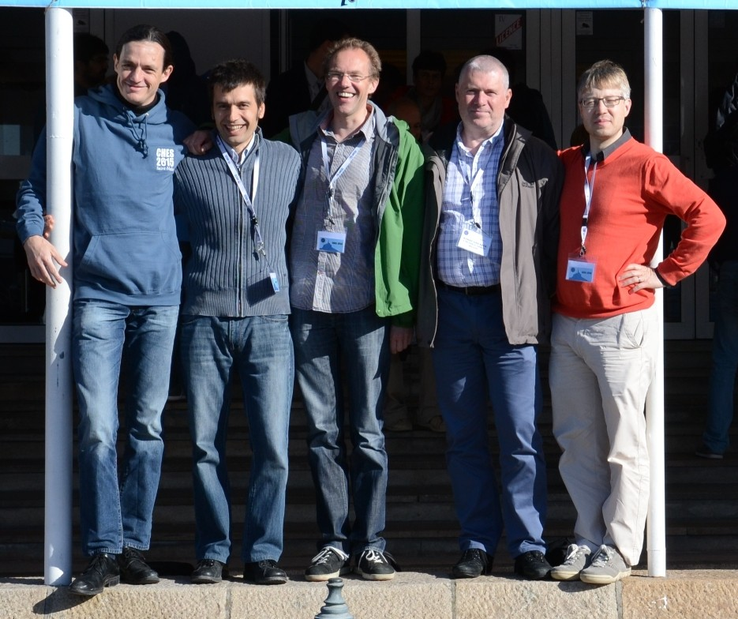
The (extended) Keccak team

Slide 13
The sponge construction
M
pad
trunc
Z
r 0
outer
f
f
f
f
f
f
inner
c 0
absorbing squeezing
Generalizes hash function: extendable output function (XOF)
Calls a b-bit permutation f, with b = r + c
r bits of rate
c bits of capacity (security parameter)

Slide 14
How to build a strong permutation
Like a block cipher
Sequence of identical rounds
Round consists of sequence of simple step mappings
…but not quite
No key schedule
Round constants instead of round keys Inverse permutation need not be eﬃcient

Slide 15
Keccak[r, c]
Sponge function using the permutation Keccak-f
7 permutations: b ∈ {25, 50, 100, 200, 400, 800, 1600}
… from toy over lightweight to high-speed …
SHA-3 instance: r = 1088 and c = 512
permutation width: 1600
security strength 256: post-quantum suﬃcient
Lightweight instance: r = 40 and c = 160
permutation width: 200
security strength 80: same as (initially expected from) SHA-1

Slide 16
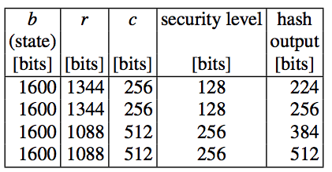
SHA-3 Parameters

Slide 17
The state: an array of 5 × 5 × 2^{ℓ} bits
state
y
z
x
5 × 5 lanes, each containing 2^{ℓ} bits (1, 2, 4, 8, 16, 32 or 64)
(5 × 5)-bit slices, 2^{ℓ} of them

Slide 18
The state: an array of 5 × 5 × 2^{ℓ} bits
lane
y
z
x
5 × 5 lanes, each containing 2^{ℓ} bits (1, 2, 4, 8, 16, 32 or 64)
(5 × 5)-bit slices, 2^{ℓ} of them

Slide 19
The state: an array of 5 × 5 × 2^{ℓ} bits
slice
y
z
x
5 × 5 lanes, each containing 2^{ℓ} bits (1, 2, 4, 8, 16, 32 or 64)
(5 × 5)-bit slices, 2^{ℓ} of them

Slide 20
The state: an array of 5 × 5 × 2^{ℓ} bits
row
y
z
x
5 × 5 lanes, each containing 2^{ℓ} bits (1, 2, 4, 8, 16, 32 or 64)
(5 × 5)-bit slices, 2^{ℓ} of them

Slide 21
The state: an array of 5 × 5 × 2^{ℓ} bits
column
y
z
x
5 × 5 lanes, each containing 2^{ℓ} bits (1, 2, 4, 8, 16, 32 or 64)
(5 × 5)-bit slices, 2^{ℓ} of them

Slide 22
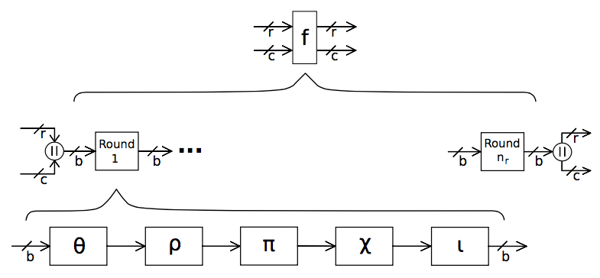
Keccak-f

Slide 23
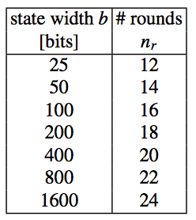
Number of rounds in Keccak-f

Slide 24
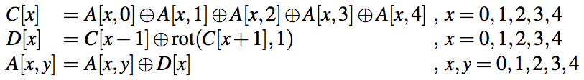
θ, a ﬁrst attempt at mixing bits
+
=
column parity
θʹ eﬀect
combine

Slide 25
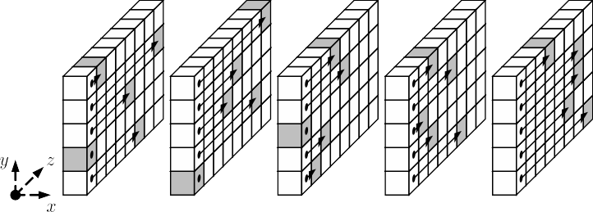
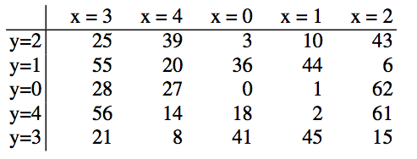
ρ for inter-slice dispersion

Slide 26
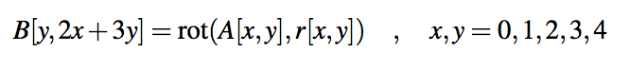
π for disturbing horizontal/vertical alignment
Notes:
X=3, Y=2, B[2, 2x3+3x2]=B[2,2]
X=3, Y=0, B[0, 2x3+3x0]=B[0,1]

Slide 27
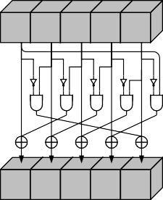
χ, the nonlinear mapping in Keccak-f
Operates independently and in parallel on 5-bit rows Cheap: small number of operations per bit
Notes:
The ones' complement of a binary number is defined as the value obtained by inverting all the bits in the binary representation of the number (swapping 0s for 1s and vice versa).

Slide 28
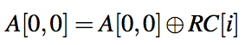
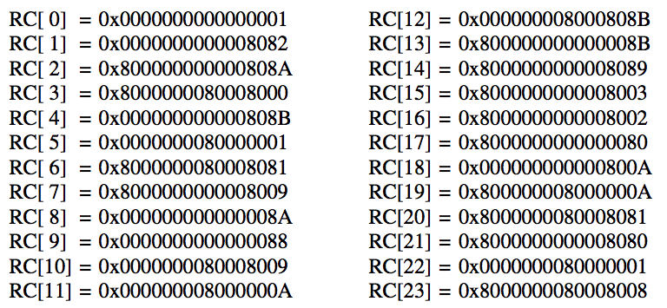
ι to break symmetry
Notes:
Iota

Slide 29
Keccak-f summary
Round function:
R = ι ◦ χ ◦ π ◦ ρ ◦ θ
Number of rounds: 12 + 2ℓ Keccak-f[25] has 12 rounds Keccak-f[1600] has 24 rounds
Eﬃciency [Keccak implementation overview]
high level of parallellism software: fast on wide range of CPU dedicated hardware: very fast

Slide 30
Keccak Security
Scope: 1 to 12 rounds, including smaller instances
Keccak[r = 40, c = 160],
Keccak[r = 240, c = 160], Keccak[r = 640, c = 160] and Keccak[r = 1440, c = 160].
Results so far:
Preimages found for up to 4 rounds Collisions found for up to 5 rounds
both by team incl. Meicheng Liu (China) and Jian Guo (Singapore)

